Slide 1
CT Project Weekly Status Report
Jack Xu, Jenny Jiang Jun 12, 2020

Slide 2
Plan for this week
Finish Analysis of solutions including Google and apple
Analyze UI/UX design of other solutions
Define features in a more specific way
Present the analysis of solutions and features of App
Our work this week
Made an in-depth research of Google/Apple API
Created UI/UX mind maps and comparisons for existing apps
Defined features CT Application is going to produce and made a design doc.
Did some basic coding including network and database.

Slide 3
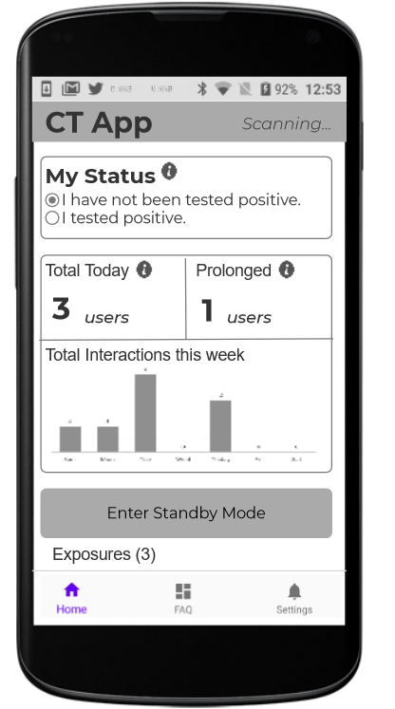
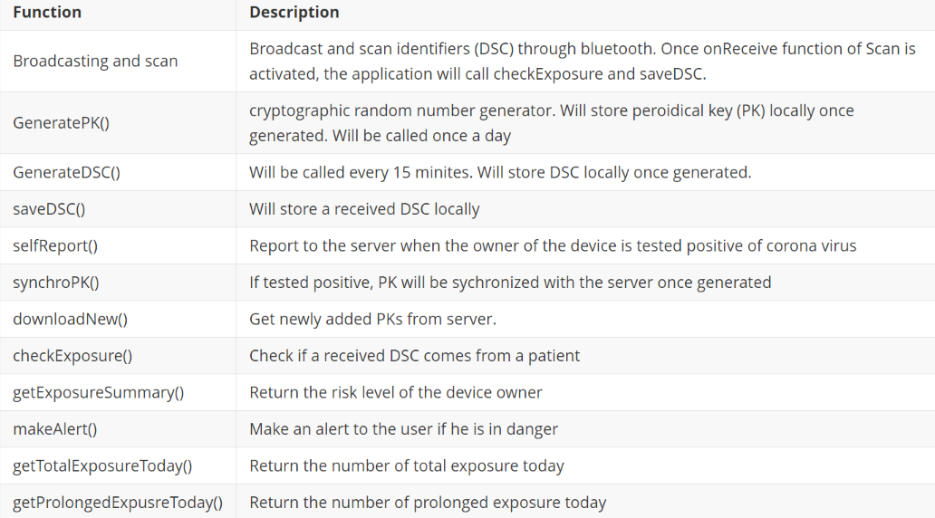
Our work this week
UI Design and Functions to be Implemented
UI Design Here

Slide 4
Plans for next week
Start the application development phase
Create use cases and scenario designs.
Finish UI/UX designs.
Try utilizing Google/Apple API and Huawei Contact Shield
Keep implementation/coding.

